Slide 1
Atari IP Catalog 2017

Slide 2
IP List (Highlighted Links are Included in Deck)
3D Asteroids
3D Tic-Tac-Toe
A Game of Concentration
Act of War: Direct Action
Act of War: High Treason
Adventure
Adventure II
Agent X *
Airborne Ranger
Air-Sea Battle
Akka Arrh *
Alien Brigade
Alone In the Dark
Alone in the Dark: Illumination
Alpha 1 *
Anti-Aircraft *
Aquaventure
Asteroids
Asteroids Deluxe *
Asteroids On-line
Asteroids: Gunner
Asteroids: Gunner+
Atari 80 Classic Games in One!
Atari Anniversary Advance
Atari Anniversary Edition
Atari Anthology
Atari Arcade Hits: Volume 1
Atari Arcade Hits: Volume 2
Atari Baseball *
Atari Basketball *
Atari Casino
Atari Classics: Evolved
Atari Football *
Atari Greatest Hits
Atari Greatest Hits: Volume 1
Atari Greatest Hits: Volume 2
Atari Mini Golf *
Atari Outlaw
Atari Revival
Atari Soccer *
Atari Video Cube
Avalanche *
Backgammon
Barroom Baseball
Basic Programming
Basketball
Basketbrawl
Bionic Breakthrough
Black Belt
Black Jack
Black Widow *
Boogie Demo
Booty
Bowling
Boxing *
Brain Games
Breakout
Breakout *
Breakout Boost
Canyon Bomber
Casino
Castles and Catapults
Caverns of Mars
Centipede
Centipede: Infestation
Centipede: Origins
Championship Soccer
Circus Atari
Cloak & Dagger *
Cloud 9 *
Codebreaker
Combat
Cops 'N Robbers *
Countermeasure
Crash 'N Score *
Crystal Castles
Dark Chambers
Demons to Diamonds
Desert Falcon
Destroyer *
Doctor Pong "aka Puppy Pong"
Dodge ’Em
Dominos *
Double Dunk
Drag Race *
Fast Freddie *
Fatal Run
Final Legacy
Fire Truck *
Firefox *
Flag Capture
Flyball *
Food Fight (Charley Chuck's)
Football
Frisky Tom
Frog Pond
Fun With Numbers
Gerry the Germ Goes Body Poppin
Goal 4 *
Golf
Gotcha *
Gran Trak 10 *
Gran Trak 20 *
Gravitar
Hangman
Haunted House
HiWay *
Holey Moley
Home Run
Human Cannonball
Hunt & Score
I, Robot
Indy 4 *
Indy 500
Jet Fighter *
LeMans *
Liberator *
Lunar Battle *
Lunar Lander *
Major Havoc *
Maze Craze
Meebzork
Meltdown
Micro-gammon
Millipede
Mind Maze
Miniature Golf
Minimum
Missile Command
Missile Command 2 *
Missile Command 3D
Monstercise
Monte Carlo *
Motor Psycho
MotoRodeo
Night Driver
Ninja Golf
Off the Wall
Orbit *
Outlaw
Outlaw *
Peek-A-Boo
Pin Pong *
Planet Smashers
Pong *
Pong Doubles *
Pong Tournament
Pong World
Pong: The Next Level
Pool Shark *
Pridefest
Pursuit *
Quadra Pong *
Quadrun
Quantum *
Quiz Show *
Qwak! *
Radar Lock
Realsports Baseball
Realsports Basketball
Realsports Boxing
Realsports Football
Realsports Soccer
Realsports Tennis
Realsports Volleyball
Rebound *
Red Baron *
Retro Atari Classics
Return to Haunted House
Roadrunner
RollerCoaster Tycoon
Runaway *
Saboteur
Save Mary
Scrapyard Dog
Secret Quest
Sentinel
Shark Jaws *
Shooting Arcade
Sky Diver
Sky Raider *
Slot Machine
Slot Racers
Smokey Joe *
Soccer
Solar War *
Solaris
Space Duel *
Space Race *
Space War
Space War 2000
Spike *
Spitfire
Sprint *
Sprint 4 *
Sprint 8 *
Sprintmaster
Star Raiders
Star Raiders II
Star Ship
Steeplechase
Steeplechase *
Stellar Track
Stock Car *
Street Racer
Stunt Cycle *
Submarine Commander
Subs *
Super Asteroids & Missile Command
Super Baseball
Super Breakout
Super Bunny Breakout
Super Football
Superbug *
Surround
Swordquest: Earthworld
Swordquest: Fireworld
Swordquest: Waterworld
Tank *
Tank II *
Tank III *
Telepathy
Tempest
Tempest 2000
Tempest: Menace of the Arcade Dwellers - Online version
Tournament Table *
Triple Hunt *
Tubes *
Typo Attack
Ultra Tank *
Video Checkers
Video Chess
Video Olympics
Video Pinball *
Warlords
Wizard
Wolf Pack *
Xari Arena
Yar's Return
Yar's Revenge
Zulu

Slide 3
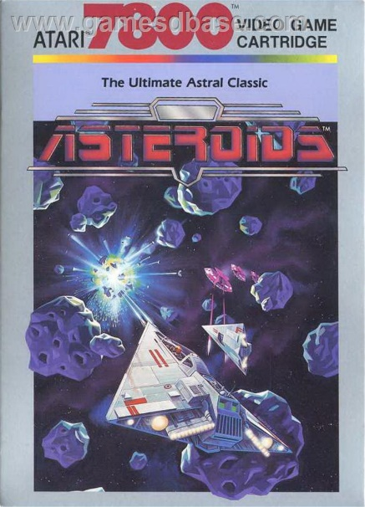
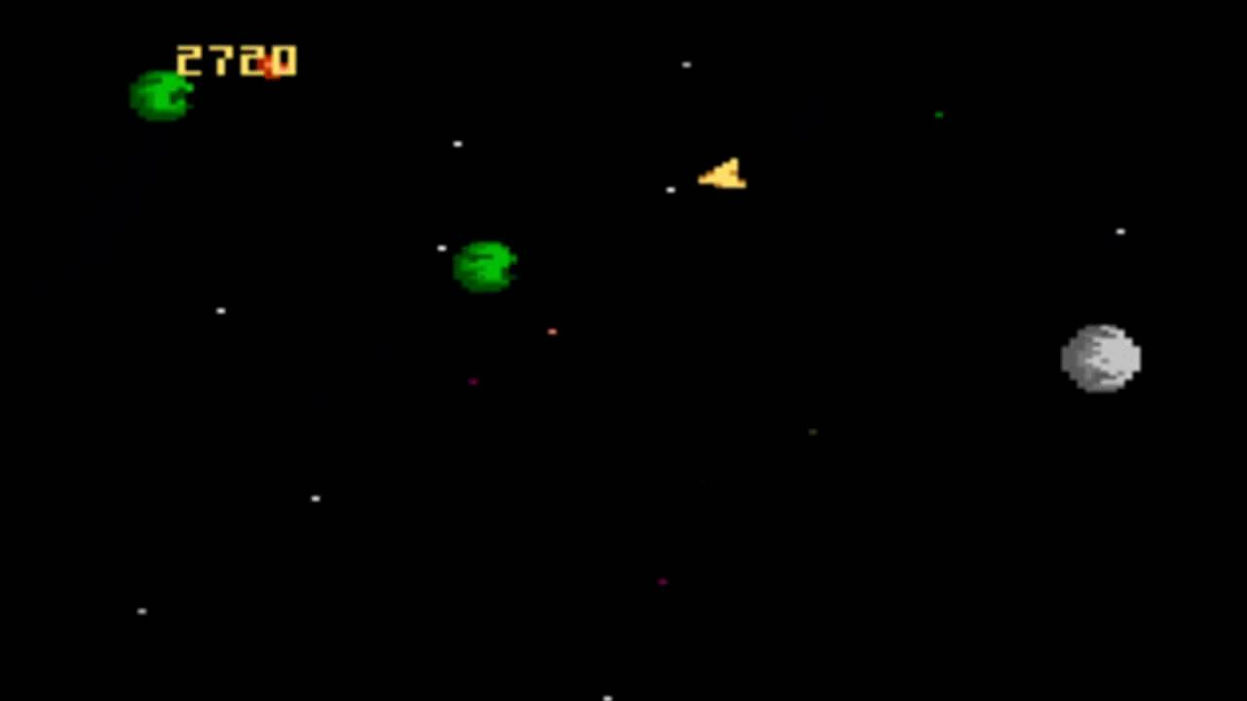
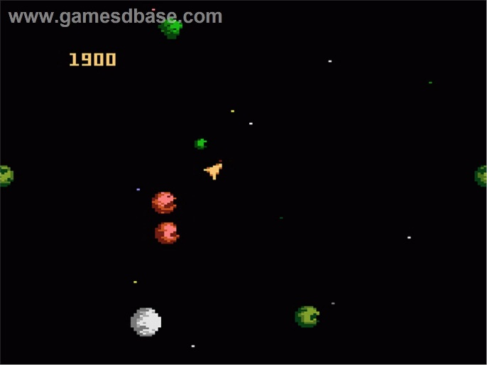
3D Asteroids
-The player controls a spaceship in an asteroid field which is periodically traversed by flying saucers.
-The object of the game is to shoot and destroy asteroids and saucers while not colliding with either, or being hit by the saucers' counter-fire. The game becomes harder as the number of asteroids increases.
-Asteroids has many sequels and successors across multiple platforms and is still regarded as one of the most influential and well-loved games of all time
-Asteroids 3D which would later come to be known as Asteroids, was released for the Atari 7800.
-Gameplay Video: https://www.youtube.com/watch?v=hH2mId8W89s

Slide 4
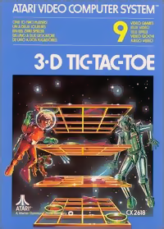
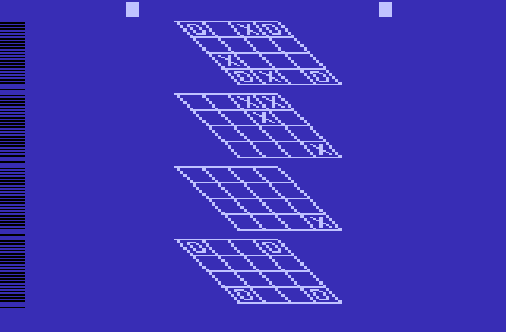
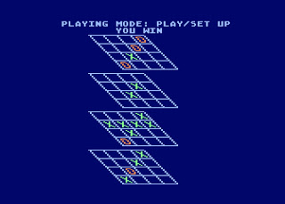
3D Tic Tac Toe
-The game is similar to the traditional game of tic-tac-toe, but is played on four 4×4 grids stacked vertically.
-To win, a player must place four of their symbols on four squares that line up vertically, horizontally, or diagonally on a single grid, or spaced evenly over all four grids.
-This creates a total of 76 possible ways to win, in comparison to eight possible ways to win on a standard 3×3 board.
-The game has nine variations: it can be played by two players against each other, or one player can play against a built-in AI on one of eight different difficulty settings.
-Gameplay Video: https://www.youtube.com/watch?v=0dfWCkyf70Y

Slide 5
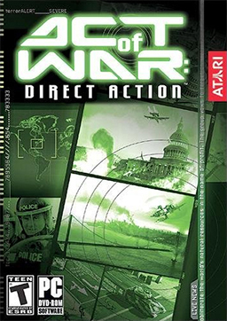
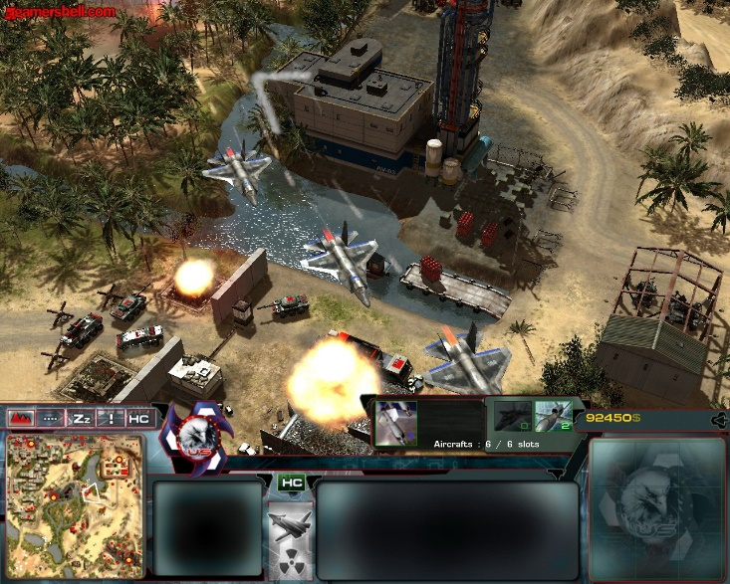
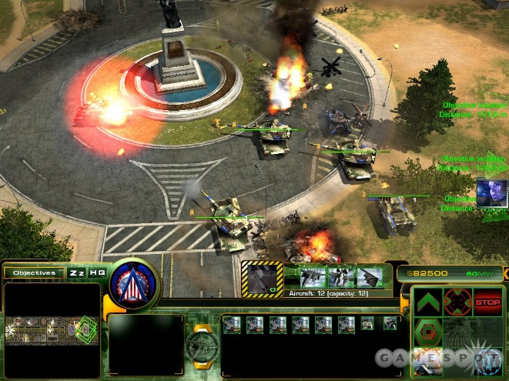
Act of War: Direct Action
Ripped from today's headlines, Act of War: Direct Action is a frightening tale of suspense, international intrigue and geopolitical military conflict. This real-time strategy experience puts you squarely in control of counterterrorist forces and delivers a first look at tomorrow's war.
Command ultra-realistic modern military units
Power-packed combination of high-end cinema, video effects and live action
Intense multiplayer operations for up to eight players
Real urban combat, including POW captures and landscape destruction
Gripping storyline by NY Times bestselling author, Dale Brow
TRAILER: https://www.youtube.com/watch?v=M7vzW7GplHQ

Slide 6
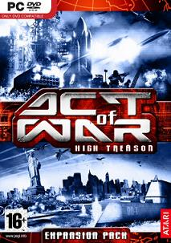
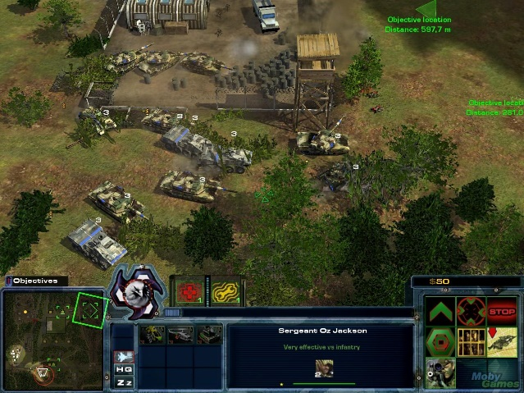
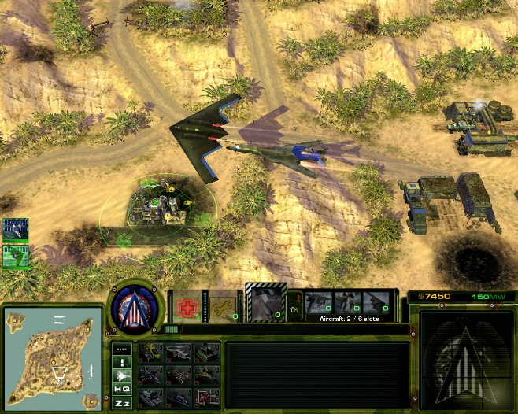
Act of War: High Treason
The highly anticipated sequel to the critically acclaimed game, Act of War: High Treason picks up where the techno-thriller left off. You take the role of U.S. Army Brigadier General Jason Richter - a career soldier and former commander of the 1st Special Forces (Delta Force) who has been given control of an elite new anti-terrorist unit: Task Force TALON.
Ultra-realistic modern military RTS with massive new features for both single and multiplayer.
Over 50 new multiplayer maps and new single player campaign.
Three new online multiplayer modes and customization options.
Naval combat with advanced water physics and expanded technologies.
Nine different mercenaries to expand the gameplay experience.
Over 50 new ships, tanks, planes, soldiers and upgrades.
GAMEPLAY VIDEO: https://www.youtube.com/watch?v=FvltL52CrXs

Slide 7
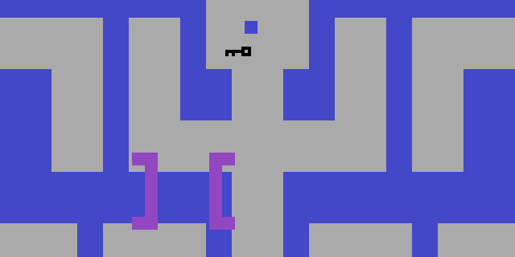
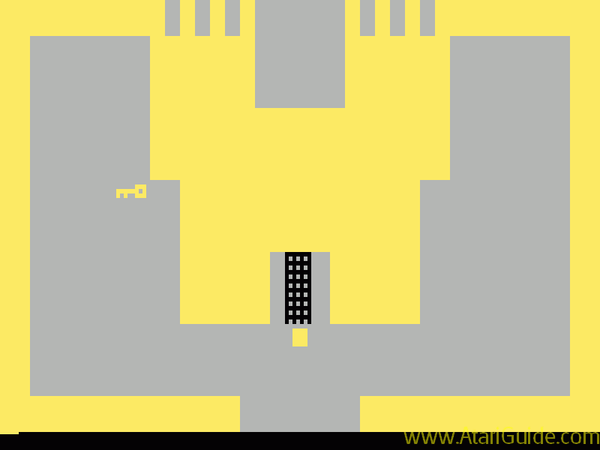
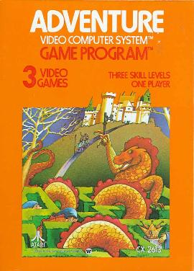
Adventure
-The player controls a square avatar whose quest is to find a magical chalice in an open world environment, returning it to the yellow castle.
-The game world is also populated by roaming enemies: dragons, which can eat the avatar; and a bat, which randomly steals and hides items around the game world.
-As the first action-adventure and console fantasy game, Adventure sold more than a million copies and essentially created the genre. It spawned a number of official and unofficial sequels, and has been included in numerous Atari 2600 collections.
-Gameplay Video: https://www.youtube.com/watch?v=sdZahXk-e9Y

Slide 8
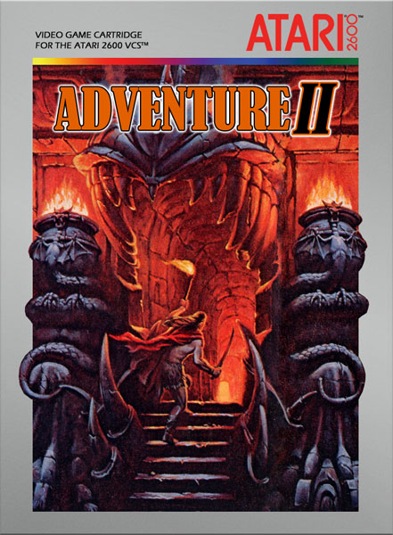
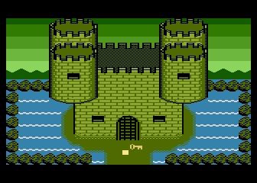
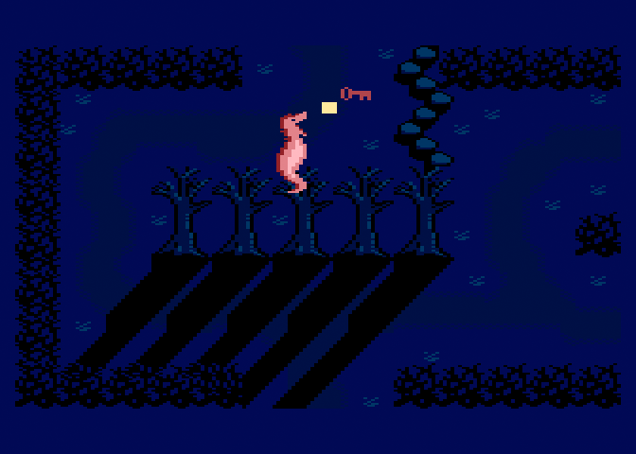
Adventure II
-Adventure II is the much-anticipated, unofficial sequel to Atari's classic Adventure on the 2600. Taking advantage of the Atari 5200's improved capabilities over the 2600, Adventure II is much larger and more detailed than the original, while still remaining faithful to the traits that made the classic Adventure memorable even after 25 years.
-Features a gripping story of an adventurer who braved dragons and dangerous mazes to return the Chalice from the forces of evil.
-Unfortunately. the Chalice is missing again. Your weapons and keys are gone from the safety of the Seashore Castle. Evil has once again stolen the Chalice and hidden it! Return this sacred Chalice to the safety of the Seashore Kingdom’s Castle!
-Gameplay Video: https://www.youtube.com/watch?v=jcJg7qupsXU

Slide 9
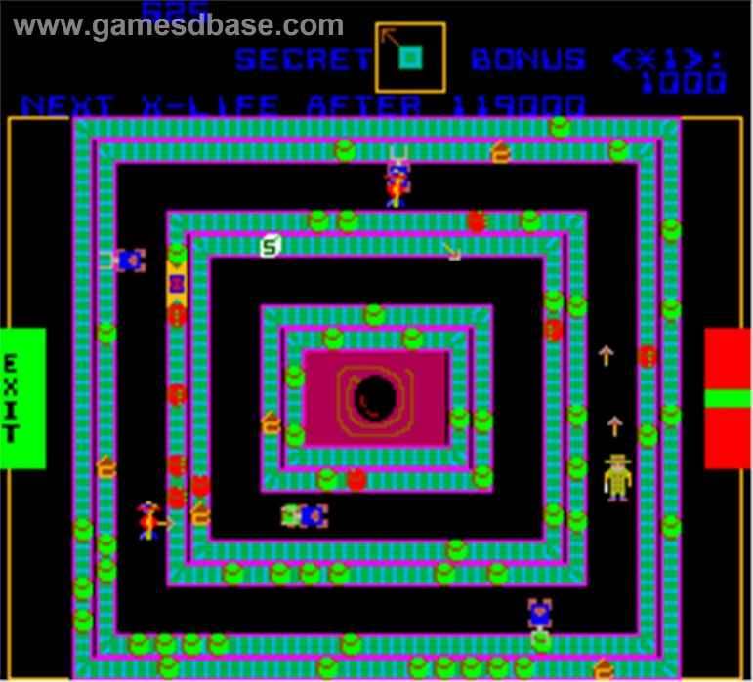
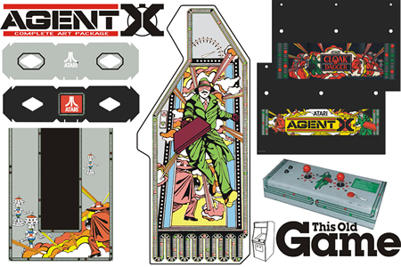
Agent X
-A horizontal scrolling fighter, this game was also released under the name “Cloak & Dagger” - Atari simply changed the title screen marquee.
-Max number of players was 2. Gameplay was alternating and came in arcade form.
-GAMEPLAY VIDEO: https://www.youtube.com/watch?v=qJ8xMjpzHOI
Property of Atari Interactive, Inc. and Atari, Inc. All Rights Reserved. Confidential
9

Slide 10
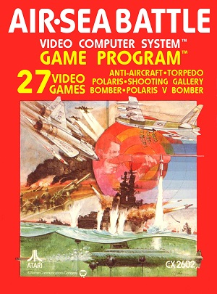
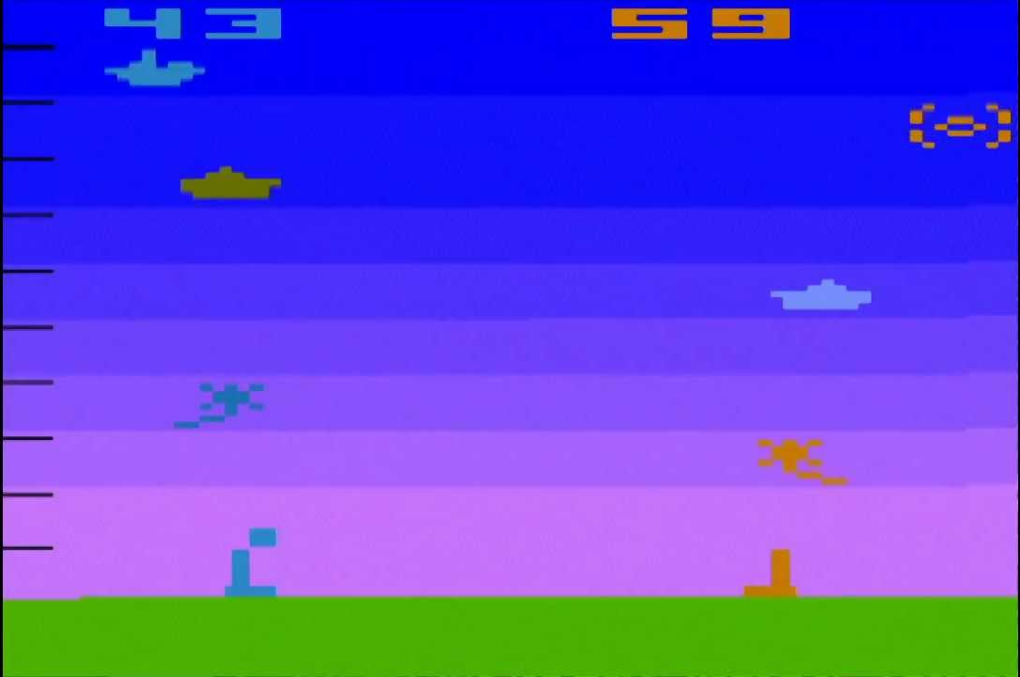
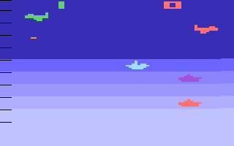
Air Sea Battle
-Released in 1977, Air Sea Battle features six basic types of games, with each type featuring one or two groups of three games - for a total of twenty-seven game variants.
-Anti-Aircraft Games, Torpedo Games, Shooting Gallery Games, Polaris Games, Bomber Games, Polaris vs. Bomber Games
-Within each group, variant one is the standard game, variant two features guided missiles which can be directed left or right after being fired, and variant three pits a single player (using the right gun) against a computer opponent.
-In every game, players shoot targets (enemy planes or ships, shooting gallery targets, or each other, depending on the game chosen) competing to get a higher score.
-Gameplay Video: https://www.youtube.com/watch?v=xhz0I_HSE2I

Slide 11
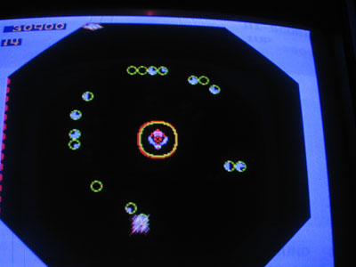
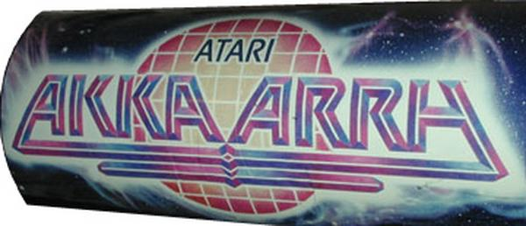
Akka Arrh
-A space shooter where you must defend your spaceship from approaching enemies and prevent them from building a cannon. The game has two main views. One shows the overall area where you electrify zones with your cursor to destroy enemies and the other is a zoomed-in view of the center of the play area.
Property of Atari Interactive, Inc. and Atari, Inc. All Rights Reserved. Confidential
11

Slide 12
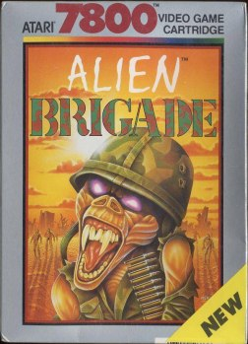
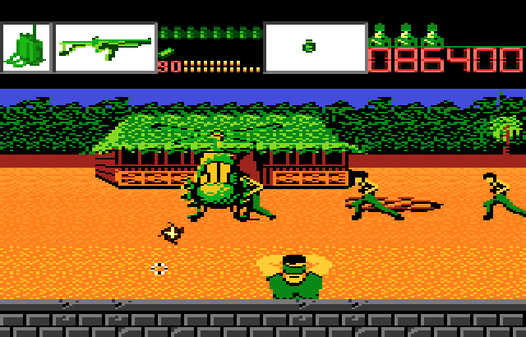
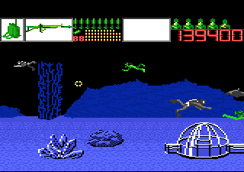
Alien Brigade
-Alien Brigade tells the story of a soldier who is forced to do battle with aliens that are invading the planet, taking over the bodies of fellow soldiers in the process.
-One of the last releases for the Atari 7800, Alien Brigade is a sought after title due to its relative scarcity and above-average graphics.
-The game takes place over five scrolling levels. The initial mission is to rescue hostages from an enemy camp, but the game then progresses to a waterfront battle, an underwater melee, a showdown in an underground mine, and a final mountaintop battle. Adding to the challenge, the player is must be careful not to accidentally shoot innocent bystanders.
-Gameplay Video: https://www.youtube.com/watch?v=qLF3HJVCwOQ

Slide 13
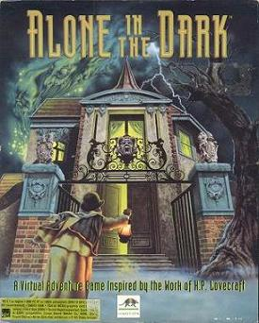
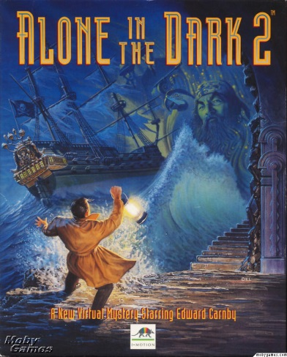
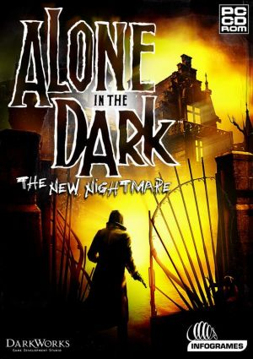
Alone in The Dark: Franchise Overview
Over 2.5MM units sold across multiple platforms, (PC, PlayStation, Xbox).
Global franchise revenues have exceeded $77MM, life to date.
The titles are still selling robustly in digital channels.
CGW named AITD the “88th best video game of all time”.
Game Informer listed AITD as “One of the top 25 most influential games of all time”.
Widely considered to be the forefather to the Survival Horror game genre.
Alone in the Dark (original) Gameplay Video: https://www.youtube.com/watch?v=iSwYY2eoKhQ

Slide 14
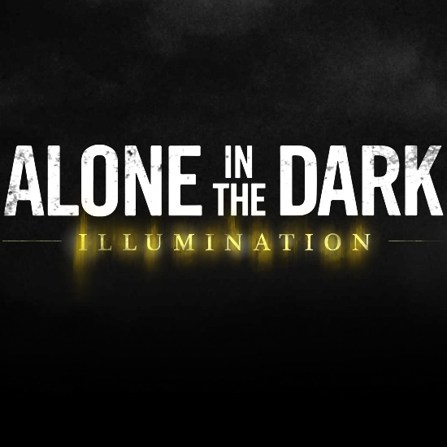
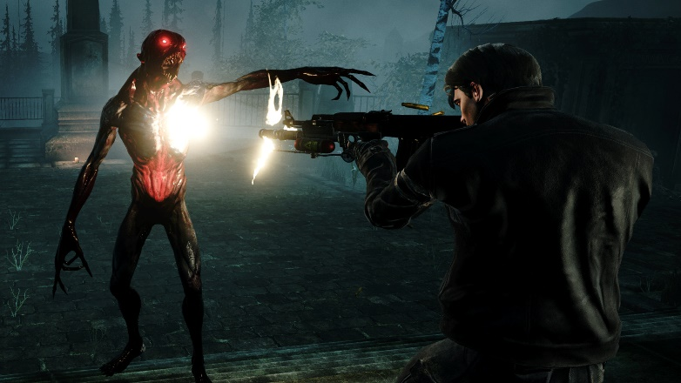
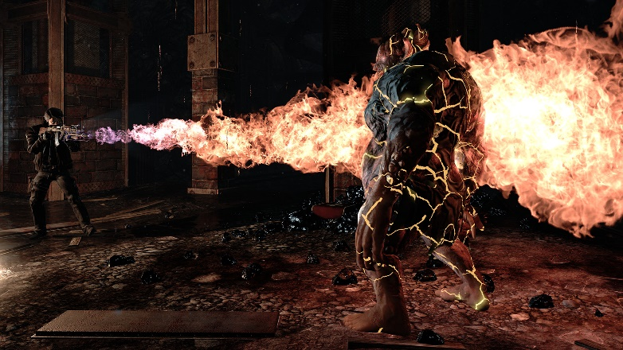
Alone in the Dark: Illumination
An all new multiplayer shooter inspired by “Father of the Survival Horror Genre”. Alone in the Dark: Illumination explores this dark legacy in a terrifying action-horror experience.
Four unique characters play in co-operative multiplayer modes
Three campaigns with multiple levels take players through the blasted landscape of Lorwich, and deep below to unearth the mysteries of this forsaken township.
Inspired by the writing of H.P. Lovecraft, beings from beyond madness.
Harness the Power of Illumination to light up maps to create safe zones, and defeat your foes.

Slide 15
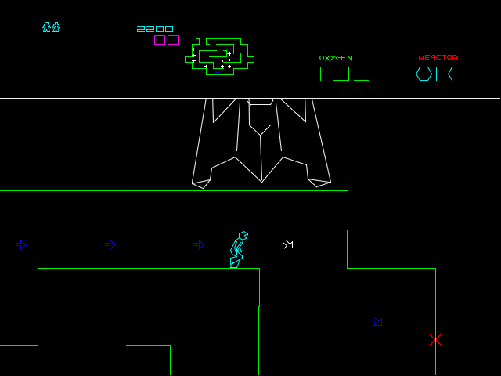
Alpha 1
-Major Havoc must search out enemy space stations, defeat their space defenses, dock with the mothership and then destroy each robot-infested mothership by setting off the reactor.
Property of Atari Interactive, Inc. and Atari, Inc. All Rights Reserved. Confidential
15

Slide 16
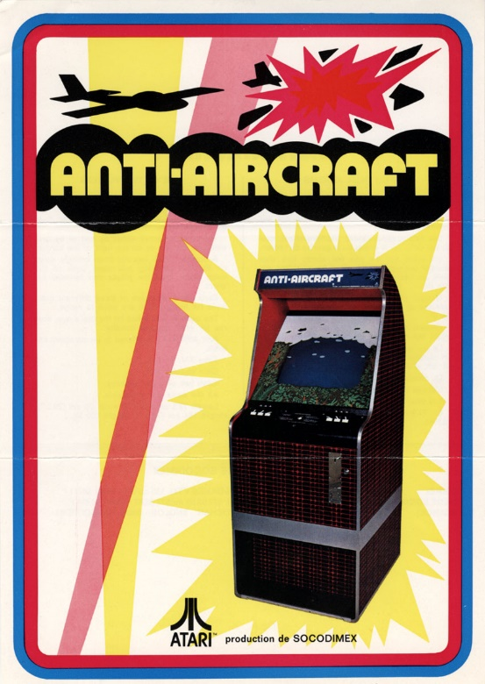
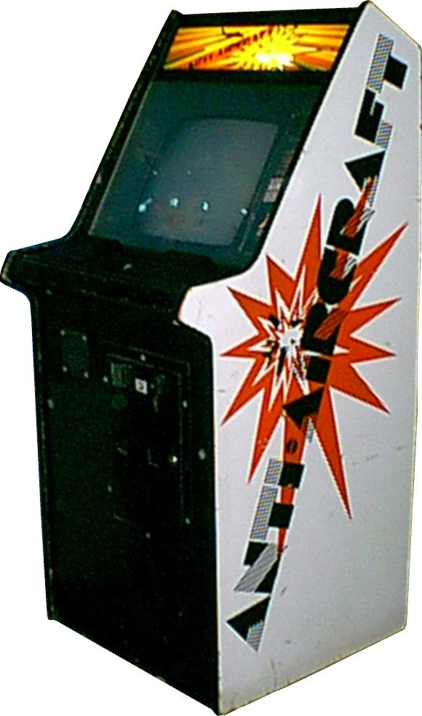
Anti-Aircraft
-Anti-Aircraft is a two-player arcade game by Atari, Inc, originally released in 1975. The game is sometimes referred to as Anti-Aircraft II, denoting the two-player aspect of the game.
-Planes fly overhead, either singly or in pairs, in random directions in the aircraft flight area. The object is to shoot down more planes than the player's opponent during the time limit.
-Each player controls an anti-aircraft gun located in the lower left and right corners of the screen, respectively. A player's gun is controlled by three buttons located in each player's control station, which consists of a button for moving up, down, and firing. The up and down buttons move the gun to any one of three predefined positions.
Property of Atari Interactive, Inc. and Atari, Inc. All Rights Reserved. Confidential
16

Slide 17
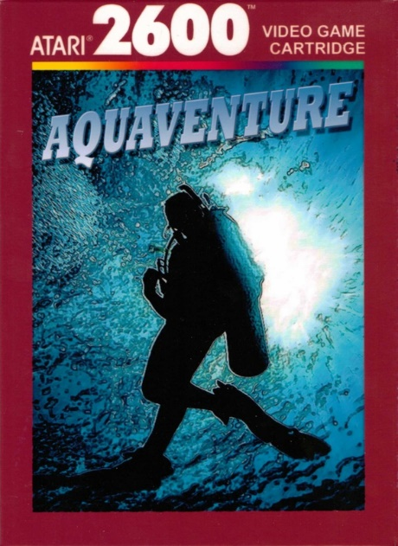
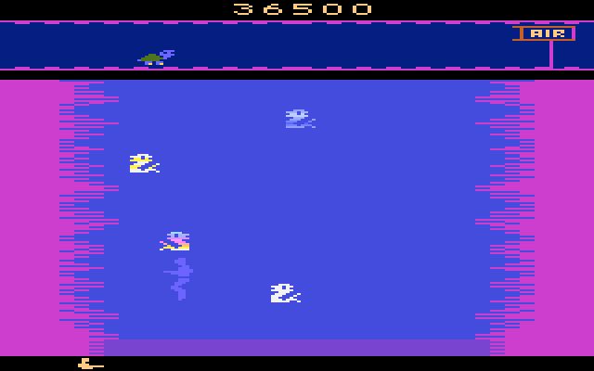
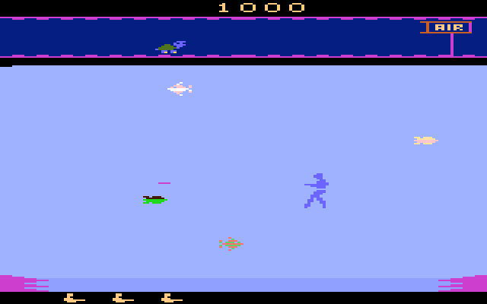
Aquaventure
-Released in 1983, your goal is to dive to the bottom of an undersea cavern and retrieve fantastic treasure.
-Along the way you must avoid fish, sea horses, and other underwater creatures.
-Your diver is armed with a spear gun which he can use to temporarily kill one of the creatures.
-After retrieving the treasure and returning it to the top of the cavern, a mermaid will appear.
-At the top of the screen there is a turtle which shows how much air you have left. If the turtle reaches the Air sign at the far end of the screen before you complete the level you lose a life.
-Gameplay Video: https://www.youtube.com/watch?v=wOTySfy40P0

Slide 18
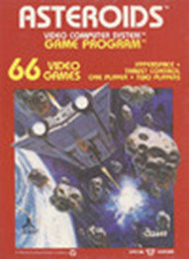
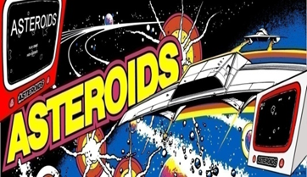
Asteroids
Released in 1979 and known as one of Atari’s legendary, genre-defining games
Atari’s best selling arcade game of all time generating over $525M in revenue
Asteroids was ranked fourth on Retro Gamer's list of "Top 25 Arcade Games"
Top Seller in Apple Appstore and Google Play in Atari’s Greatest Hits
Globally recognized,
iconic imagery
Original Gameplay
PSP Gameplay 2007

Slide 19
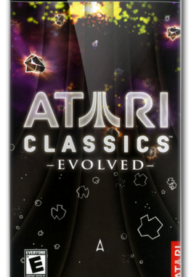
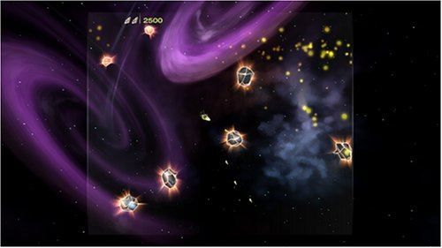
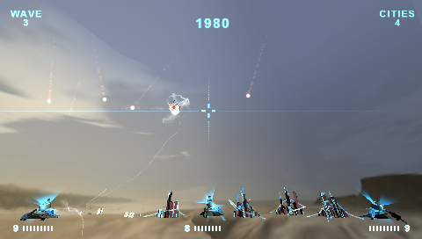
Atari Classics: Evolved
-Atari Classics Evolved, released in 2007, features games including Asteroids, Asteroids Deluxe, Battlezone, Centipede, Lunar Lander, Millipede, Missile Command, Super Breakout, Tempest, Warlords and Pong.
-The titles are presented in both their original and evolved versions maintaining original gameplay while providing up-to-date graphics.
-In addition to the "evolved" titles, an additional 60 original Atari 2600 titles can be played.
-Online leaderboards are also available for the original coin operated games.
-Gameplay Video: https://www.youtube.com/watch?v=sTACKXuCsjM

Slide 20
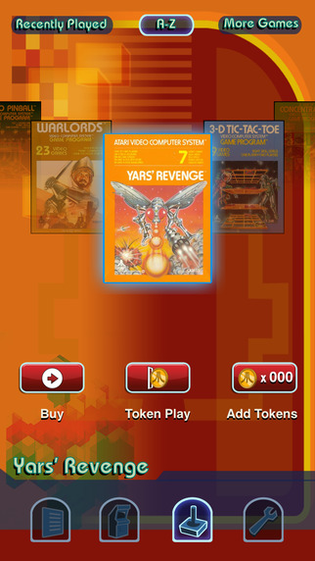
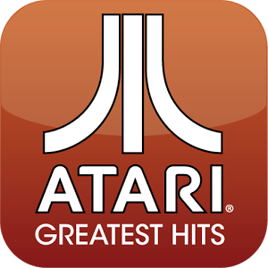
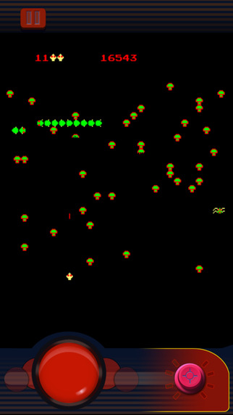
Atari Greatest Hits
Atari Greatest Hits (Mobile)
-Download for free on App Store and Google Play
-Over 9 million downloads in the App Store
-Relive the Golden Age of Gaming with a collection of the most popular retro games from the 70s and 80s, including Asteroids, Centipede, Warlords, Tempest, and many more.
-This extensive catalog pays homage to each of the originals, with controls designed to mimic what Atari fans remember from 30 years ago!

Slide 21
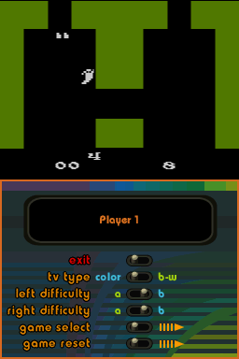
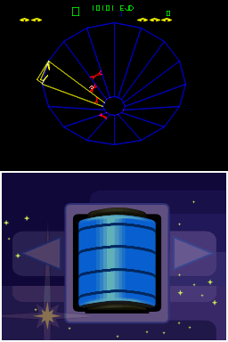
Atari Greatest Hits Volume 1
-Released in 2010, Atari Greatest Hits Volume 1 delivers 50 iconic Atari games to the Nintendo DS.
-The compilation game simply gives you the best of Atari's vast catalog of classic games
-With 50 all-time favorites including Pong, Asteroids, Centipede and Missile Command and available single cartridge multiplayer, the fun never ends for lovers of retro gaming.
-Gameplay Video: https://www.youtube.com/watch?v=a5BxeFwozKw

Slide 22
Atari Greatest Hits Volume 2
-Released in 2011, Atari Greatest Hits Volume 2, delivers 50 more iconic Atari games to the Nintendo DS. The compilation game simply gives you the best of Atari's arcade and 2600 games.
-With 50 games on one cartridge and available multiplayer and iconic favorites, the fun never ends. For those who love the classic gaming experience, this handheld breakthrough is sure to guarantee hours of fun on the go.
-Up to 4 player single and multi-cartridge multiplayer for head-to-head titles such as Warlords, Street Racer, Video Olympics and Casino.
-Special video interview series with Nolan Bushnell, founder of Atari.
-Gameplay Video: https://www.youtube.com/watch?v=Jj9sha17fI4

Slide 23
Avalanche
-Avalanche is an arcade game released by Atari in 1978. The object is to catch falling rocks with a controllable set of paddles that diminish in number and size as the rocks fall faster and faster.
-Avalanche is for 1 or 2 players, with no simultaneous gameplay. There are six rows of rocks to deal with. The game starts with a six-storied platform and the player loses one platform per row of rocks cleared. The player scores points for those rocks they prevent from reaching the ground. The farther the row of rocks, the smaller and faster they become. The ultimate goal is to get enough points so that the player can continue the game should they lose their first one.
-Gameplay Video: https://www.youtube.com/watch?v=0VDvRlNuaX4

Slide 24
Backgammon
-Released in 1978 on the Atari 2600, Backgammon is a simple, classic board game that involves moving pieces from one side of the board to the other.
-The board is nicely rendered on the screen and you can easily see what’s going on as the pieces are being moved.
-Eight play variations let you compete against the computer or another person.
-Gameplay Video: https://www.youtube.com/watch?v=aK0PFA3oJkc

Slide 25
Barroom Baseball
-An unreleased Atari title from 1983, Barroom Baseball was a game prototype never intended for home use.
-Virtually identical to Realsports Baseball, Barroom Baseball was specifically designed to be used in arcade cabinets in bars, running off a coin-operated timer.
-Three minutes of playtime cost $.25, and players could pay at the end of three minutes for additional gameplay time.
-A robust baseball experience, featuring complete feature-filled gameplay including hitting, pitching, catching, throwing, base running and stealing, and more.
-Gameplay Video: https://youtu.be/OG3vl1xGXs0

Slide 26
Basketbrawl
-Basketbrawl is a video game released for the Atari 7800 in 1990 and the Atari Lynx in 1992. It is a sports simulation while also a “beat-em up” at the same time.
-Released in 1990, this Atari game featured six selectable characters, each with their own strengths and weaknesses, not just two generic teams like most Atari sports games. It also featured three different courts and a referee that throws knives at the athletes. The two man teams try to score and/or knock each other out with either fists or the ball.
-The most interesting aspect of the game is when a teammate is knocked out and you are forced to keep playing games as long as possible alone.
-Gameplay Video: https://www.youtube.com/watch?v=ZmgStnd3_HQ

Slide 27
Black Belt
-Long before there was Karateka, there was Black Belt. Black Belt was Atari's entry into the martial arts genre at a time when such games were almost unheard of. Black Belt is a multi-screened action game with amazing visuals and easy to understand controls. Had it been released, Black Belt would have been years ahead of its time and a solid entry into the 5200 library.
-Gameplay Video: http://gamesdbase.com/game/atari-5200/black-belt.aspx
27

Slide 28
Black Widow
Black Widow was first released into the arcade in 1982, with additional versions on PlayStation 1, PlayStation 2, Xbox, Xbox 360, PC and the Nokia N-gage.
The player moves the widow around the web with the left joystick, while controlling directional firing with the right, similar to Robotron 2084
A key innovation is the interaction between enemies. Certain enemies can only be destroyed by other enemies, some eat power ups, and others evolve over time
10 unique enemies and power ups populate the web as the player seeks to avoid attacks and destroy as many bugs as possible to push for a high score.
28

Slide 29
Breakout & Super Breakout
-Breakout and Super Breakout were influenced by the 1972 Atari arcade game Pong, and built by Steve Wozniak with help from Steve Jobs (Breakout).
-In the game, a layer of bricks lines the top third of the screen. A ball travels across the screen, bouncing off the top and side walls of the screen. When a brick is hit, the ball bounces away and the brick is destroyed. The player loses a turn when the ball touches the bottom of the screen; to prevent this from happening, the player has a movable paddle to bounce the ball upward, keeping it in play.
-The original arcade version of Breakout has been officially ported to several systems, and is certainly one of Atari’s most iconic titles.
-Gameplay Video: https://www.youtube.com/watch?v=Up-a5x3coC0

Slide 30
Canyon Bomber
-Canyon Bomber is a black-and-white 1978 arcade game which was also ported in color to the Atari 2600, also in 1978.
-In the game, the player and an opponent fly over a canyon made up of layers of numbered, circular "bricks". Using the paddle controllers, the players drop bombs in the canyon, breaking bricks. Players earn points for the number and types of bricks destroyed
-Canyon Bomber is unique in that the game is controlled entirely with one button, unique for games of the period.
-As the amount of bricks is reduced, it becomes harder and harder to hit the bricks without missing; if the player misses the bricks three times, the game is over.
-Gameplay Video: https://www.youtube.com/watch?v=8_i1UJRL960

Slide 31
Casino
-Casino is a gambling game simulator for Atari 2600, where players participate in games of Blackjack, Five-Card Stud Poker, and Poker Solitaire – all controlled via Atari Paddles.
-Each game featured an AI dealer, with bets made by rotating the wheel on the controller and pressing the button.
-Atari has revived the Casino brand by entering the world of free-to-play and real money gaming sites, via ataricasino.com and atarijackpots.com, where players can enjoy a number of digital games, including Slots, Hold-Em, Keno and more.
-Gameplay video:https://www.youtube.com/watch?v=4XN2FNS1CKM

Slide 32
Castles and Catapults
-Assemble an army of warriors and march them into battle -- you'll need the right mix of longbowmen, pikemen and men-at-arms for a successful siege
-Use your strategic skills to replenish your attacking armies or bolster your own defenses
-Command your siege engines to demolish the enemy castle - catapults, giant crossbows, and even cannons
-Send in your knights, wizards and even dragons to the field of battle -- use them all strategically to claim victory!

Slide 33
Caverns of Mars
-Caverns of Mars is a vertically scrolling shoot 'em up similar in concept and visual style to the 1981 arcade game Scramble.
-It became the best selling APX title of all time, eventually being released by Atari in game cartridge format.
-Using a joystick, the player controls a ship descending into the tunnels of Mars, firing at targets along the way. The player's spacecraft features two cannons, positioned on either side of the craft, firing downwards. The player needs to avoid hitting the cavern walls, while shooting targets of opportunity along the way. Fuel tanks can be shot to add 5 points of fuel, and the craft is destroyed if it runs out.

Slide 34
Centipede
-Centipede is a vertically oriented shoot 'em up arcade game produced by Atari, Inc. in 1981. The player defends against centipedes, spiders, scorpions and fleas, completing a round after eliminating the centipede that winds down the playing field.
First released in 1980, Centipede generated over $450M in revenue to date,
-The player is represented by a small, "somewhat humanoid head" at the bottom of the screen, later depicted as a caped, elf-like character on cartridge graphics for the home system versions of the game.
-As one of the most famous arcade games of all time, Centipede has enjoyed numerous sequels, ports and adaptations to a variety of consoles, systems and platforms.
-Gameplay Video: https://www.youtube.com/watch?v=xGEZ3NNH6cs

Slide 35
Circus Atari
-Released in 1981, Circus Atari challenges your reflexes. Try to pop the balloons by bouncing the clown on the teeter-totter. The more difficult the pop, the more you score.
-Choose from eight game variations.
-Play single player and two player modes.
-Gameplay Video: https://www.youtube.com/watch?v=BVODkDgY4JQ

Slide 36
Cloak & Dagger
-Cloak & Dagger is an Atari video game based on the 1984 film of the same name. The video game was critical to the film's plot.
-Agent X, complete with trenchcoat, Bogie hat and briefcase, hurries through a series of floors to retrieve stolen plans and destroy Dr. Boom's underground bomb factory. The hero descends in a special elevator and on each floor he encounters conveyor belts with moving explosives, bomb converters, forklifts, robot guards, acid pits, and death-ray shooting eyeballs. On the final level, Agent X meets the notorious Dr. Boom himself.

Slide 37
Cloud 9
-Prototype – never released game.
-Designed and programmed by Paul M. Resch, Cloud 9 was originally supposed to be written by Dona Bailey (the coder for Centipede), but she left and Paul inherited it.
-The original game concept had a plug in the bottom of the screen that the character had to pull to let the water out. This game unfortunately only received one weekend of play testing at one location before being cancelled.

Slide 38
Code Breaker
-Code Breaker is a math puzzle game released for the Atari 2600 in 1978. Code Breaker required the Keyboard controller to play.
-The goal of Code Breaker’s single player mode is to guess the right number in as few guesses as possible.
-There is also a multiplayer mode called “Nim”. In Nim players are given a set number of items displayed in stacks. During each player’s turn he or she can choose to take one, some, or all items in a single stack. The last player to take an item is the winner. -Gameplay Video: https://www.youtube.com/watch?v=NinlpBzKxw8

Slide 39
Combat
-Combat was released as one of the nine launch titles for the system in September 1977, and was included in the box with the system from its introduction until 1982. Combat was based on two earlier black-and-white coin-operated arcade games produced by Atari: Tank and Jet Fighter
-Another set of level choices in Combat were the Biplanes. Unlike the Tank version, this was played with three types of firing shots (straight-missile, guided missile, and machine guns).
-Very similar to the Biplanes level was the Jets option. In this mode, only straight missile and guided missiles were used. It still had the same map options and squadron options as the biplanes mode, with Jets flying singly, two-on-two, or three-on-three.
-Gameplay Video: https://www.youtube.com/watch?v=9E8xnaWm2Cg

Slide 40
Cops N Robbers
-Cops N Robbers is an action game for PC and the Atari 8-Bit family of computers, developed by Mike Davis in 1985. The player controls famed diamond thief, Fingers Lonegan. He must make his way through various stages, including the Acme Diamond Company and garden maze, by navigating mazes and shooting police officers.
-Along the way, the player collects diamonds and solves basic puzzles in order to complete the game and achieve high scores.
-The game was very controversial for its time, and was heavily criticized for the fact players could shoot and kill police officers.
-Gameplay Video: https://www.youtube.com/watch?v=8orKZ7s1jO0

Slide 41
Countermeasure
-Terrorists have captured a missile silo complex and are threatening Washington with a nuclear attack.
-Armed with your supertank you must either destroy all seven silos in the complex before the launch timer reaches zero, or enter a silo and guess correctly the fail-safe code to stop the launch.
-The terrorists use pillboxes (gun turrets), cruise missiles, jeeps, and tanks to hamper your progress.
-If a player fails to crack the code to stop detonation they will see missiles tracking across a world map and falling on Washington.

Slide 42
Crash ‘N Score
-Crash ’N Score is a monochrome two-player arcade game released in 1975.
-Crash ’N Score is a demolition derby “simulator” of sorts where each player competes for points. Points are allotted by running over numbered flags before a timer runs out. Points can also be earned by crashing into the other player.
-Gameplay Video: https://www.youtube.com/watch?v=R75wNfxOuB8

Slide 43
Crystal Castles
-Crystal Castles is an arcade game released by Atari, Inc. in 1983. The player controls a cartoon bear by the name of Bentley Bear, who has to collect gems located throughout trimetric-projected rendered castles while avoiding enemies out to get him as well as the gems.
-Crystal Castles has nine levels with four castles each, and a tenth level which features a single castle — the clearing of which ends the game. Each of the 37 trimetric-projected castles consists of a maze of hallways filled with gems and bonus objects, and also includes stairs, elevators and tunnels that the player can use as shortcuts.
-Crystal Castles has been ported to many platforms and enjoys a stellar reputation as one of the best classic arcade games of all time
-Gameplay Video: https://www.youtube.com/watch?v=l2QWEBSZpw8

Slide 44
Dark Chambers
-Dark Chambers is a spiritual successor to the arcade classic Gauntlet
-Players must work their way through twisty mazes, shooting (throwing daggers) at monsters and their generators, while trying to collect treasures and food.
-Dark Chambers brought the Atari 2600 into the modern age with level intermission titles, simultaneous two player action, a detailed title screen, large open levels, and other features not often seen in 2600 games.
-Gameplay Video: https://www.youtube.com/watch?v=5ht1SeYfjoI

Slide 45
Demons to Diamonds
-Demons To Diamonds is an action game developed by Atari for the Atari 2600, wherein 1-2 players control a cannon at the bottom of the screen, firing vertical lasers at demons that move horizontally across it.
-The player must shoot demons that match the color of the cannon. Doing so turns those demons into diamonds, which quickly fly across the screen and can be collected for high scores. Shooting a wrong-colored demon turns it into a skull, who can then fire back at the player with its own laser beam.
-The player can control the distance of the laser shot by releasing the controller button at the desire height.
-Gameplay Video: https://www.youtube.com/watch?v=oGxzjCsMCqc

Slide 46
Desert Falcon
-Desert Falcon is an isometric shooter where one to two players takes control of flying falcon in an Egyptian-themed setting.
-Gameplay is most similar to games like Zaxxon, but in Desert Falcon players can land and move on the ground. A variety of enemies attack the player either via land, air or sea. Power ups could be earned by running over the right combination of items on the ground.
-Originally released on the Atari 7800 in 1987 Desert Falcon was also released on the 2600 and Atari home computers.
-Gameplay Video: https://www.youtube.com/watch?v=UYEcJt9Auc8

Slide 47
Dodge ‘Em
-Dodge ‘Em is a driving game based on a single screen of four concentric roadways, where the player controls one car and has to drive counter-clockwise, avoiding computer-controlled cars whose sole aim is to produce a head-on collision.
-Each roadway of the maze has four gaps in it the player can use the gaps to change lanes in order to pick up other dots or to avoid the computer-controlled cars.
-This game mechanic spawned a number of imitators, including Sega’s Head On.
-Gameplay Video: https://www.youtube.com/watch?v=d1edvROHa8k

Slide 48
Dr. Pong
-Dr. Pong, also referred to as Puppy Pong was a version of Pong designed to be used outside of arcades.
-Dr. Pong was intended to be used as a form of entertainment / distraction in pediatric wings and children’s hospitals.
-Gameplay Video: https://www.youtube.com/watch?v=x-zh1subupA

Slide 49
Fatal Run
-The year is 2089. A collision with a comet has left the earth reeling from radiation poisoning. There's little hope for humanity's survival and it's up to you to help the few remaining people survive. You must leave the protective fortress of Albagon and deliver the newly-developed radiation vaccine to the survivors. However, your journey will not be an easy one - nefarious henchmen are waiting to knock you off and steal the vaccine to ensure that they will survive to rule the planet. Every driver on the road is out to get you, your only hope is to get them first.
-Fatal Run holds a special place in Atari history as the only 32k game to be released for the 2600 (for comparison, the first 2600 games were only 2k).

Slide 51
Food Fight (Charley Chuck’s Food Fight)
-The player guides Charley Chuck, a young boy trying to traverse a hostile environment to reach an ice cream cone before it melts - all while four chefs attempt to stop him.
-To win, the player must bring Charley Chuck from one end of the stage to the other, avoiding the chefs and reaching the ice cream cone before it melts completely.
-The stage is scattered with various food items, which can be picked up by both Charley and the chefs, and tossed at each other. Food that hits the chefs knocks them out temporarily, while food that hits Charley makes him instantly lose one life.
-Developed for the Atari 7800 in 1983 by General Computer Corporation, creators of Ms. Pac Man.
-Gameplay Video: https://youtu.be/yQ8qNjya0B0

Slide 52
Frisky Tom
Frisky Tom was initially released by Nichibutsu into arcades in 1981. A version was created for the Atari 5200 in 1983, but never released
The goal of the game is to provide water for the showers of scantily clad bathers by crawling through a network of pipes to repair loose pieces.
Various mice threaten Tom by knocking pipes loose, falling on our hero, and setting bombs.
The stage ends when the water tank runs out, or if the purple mouse is able to detonate the bomb.
Notes:
Frisky Tom is a 1981 arcade game by Nichibutsu. The object of the game is to provide enough water for a shower by crawling along a network of plumbing pipes and picking up/replacing loose pieces. Various types of mice are the game's antagonists, trying to thwart Tom in different ways: knocking pipes loose to disrupt the water flow, jumping down to fall on him, or setting a bomb to blow up the entire plumbing arrangement. A version for the Atari 5200 was programmed in 1983, but was never released.^{[1]} It was, however, released for the Nintendo Game Boy in 1995, and the PlayStation in 2002. Bandai Electronics created a VFD hand held game of Frisky Tom in 1982.

Slide 53
A Game of Concentration
-A Game of Concentration (also known simply as Hunt & Score and Concentration) is a video game produced by Atari, Inc. and released in 1978 for its Atari 2600 video game system. The game was programmed by Jim Huether, and is a video version of the classic memory game. It was one of a handful of games that used Atari's keypad controllers.
-The game is played using a matrix of numbered panels, either 4 x 4 (for 16 panels) or 5 x 6 (for 30 panels). Using the keypad, players enter the number of the panels they wish to reveal. If the images behind the two panels match, the panels are removed and the player scores 1 or 2 points, depending on what difficulty the switch is set to, along with an extra turn.
-GAMEPLAY VIDEO: https://www.youtube.com/watch?v=76S5GoSvaDM
Property of Atari Interactive, Inc. and Atari, Inc. All Rights Reserved. Confidential
53

Slide 54
Gotcha
-Gotcha is a two-player maze game where the objective is to catch the other player. A maze is displayed on the screen. The first player controls the Pursuer which is represented by a square and the second player controls the Pursued which is represented by a plus sign. As the Pursuer moves closer and closer to the Pursued, an electronic beep sound increases in frequency to a feverish pitch until the Pursuer catches the Pursued. -This was the first maze arcade game, as well as the very first video game to cause a considerable amount of controversy, predating other early examples such as Death Race by several years. It was controversial due to the controls being perceived as pink rubber bulges that were meant to represent breasts and were squeezed in order to control the action- these were changed to joysticks later on.
-Gameplay Video: https://www.youtube.com/watch?v=FoDZoZqsHF8

Slide 55
Gran Trak
-Gran Trak 10 was produced by Atari in 1974.
-The player races against the clock to accumulate points for distance covered driving around a 2-D track. The car will spin out if it runs into the "pylons" (white blips) along the side of the road. There are also a few "oil slicks" (dark patches) on the course where the car's direction of travel cannot be manipulated.
-The vehicle must pass check points in order. When the timer reaches 0, the player can compare his score to a small chart on the machine for a play rating.
-Gameplay Video: https://www.youtube.com/watch?v=o4aFdMcQODI

Slide 56
Gravitar
-Gravitar is a shoot 'em up arcade game released by Atari, Inc in 1982
-In the game, the player controls a small blue spacecraft. The game starts in a fictional solar system with several planets to explore. If the player moves his ship into a planet, he will be taken to a side-view landscape. Unlike many other shooting games, gravity plays a fair part in Gravitar: the ship will be pulled slowly to the deadly star in the overworld, and downward in the side-view levels.
-In the side-view levels, the player has to destroy red bunkers that shoot constantly, and can also use the tractor beam to pick up blue fuel tanks. Once all of the bunkers are destroyed, the planet will blow up, and the player will earn a bonus. Once all planets are destroyed, the player will move onto another solar system.
-Gameplay Video: https://www.youtube.com/watch?v=mm-EIfj_xoY

Slide 57
Haunted House
-Represented by a pair of terrified, floating eyes, the player must navigate a mansion haunted by the ghost of Zachary Graves, recovering pieces of an urn and uncovering the mystery of the haunted house - all while avoiding bats, tarantulas, and the ghost of Mr. Graves himself.
-To progress, the player must identify and pick up various items, which can only be found by lighting a match, shedding light around the player for a short time. Anytime a monster enters the stage, a howling wind blows and the match is snuffed out.
-The game features a total of nine different levels of increasing difficulty.
-Developed for the Atari 2600 in 1982 by Atari Inc.
-Gameplay Video: https://youtu.be/lbjVffUGjxA

Slide 58
Hi-Way
-Hi-Way is a single-player car racing arcade game, developed and released by Atari in 1975.
-Players sit in a cockpit arcade cabinet, using pedals and a steering wheel to dodge other cars and navigate around turns.
-Marketed with the slogan “Hi-Way – All it Needs is Wheels”, it was Atari’s first game to use a cockpit arcade cabinet design.
-Gameplay Video: https://www.youtube.com/watch?v=HA6blEgS2jE

Slide 59
Human Cannonball
-Human Cannonball is a single player shooting/targeting game developed for the Atari 2600 in 1978.
-In Human Cannonball, the player must adjust the angle of fire for a cannon, and estimate the trajectory for the circus performer inside with the intention of landing him in a small pool of water on the side of the screen.
-The player has to take wind and distance into account, and eventually obstacles that force the player to shoot at specific angles.
-The game featured impressive trajectory calculation for the time.
-Gameplay Video: https://www.youtube.com/watch?v=s9d3S-heZ9k

Slide 60
Liberator
-Liberator is an arcade game based on the Atari Force comic book series. Atari Force was published by DC Comics from 1982 to 1986. The story "Code Name: Liberator" describes the premise of the arcade game in detail and was included as a special insert in two comic books cover dated January 1983. Characters and concepts from the comic exist throughout the game. In the opening screen of the arcade game, Commander Champion of the Atari Force asks you to help free the galaxy from the evil Malaglon Army. Commander Champion of the Atari Force has chosen you as the Liberator.
-Gameplay Video: https://www.youtube.com/watch?v=I39JTSEZy34

Slide 61
Lunar Battle
-Lunar Battle was released by Atari as an arcade cabinet game in 1982, and featured 2-player alternating gameplay.
-The game is a shooter, and requires the player to blast enemies while acquiring and conserving fuel.
-There are two galaxies populated with varying enemies and goals.
-Lunar Battle was the precursor game to the well-recognized and successful Atari game Gravitar
-Gameplay video: http://www.gamesdbase.com/game/arcade/lunar-battle.aspx

Slide 62
Lunar Lander
-Lunar Lander is an arcade game released by Atari, Inc. in 1979, which uses a vector monitor to display graphics.
-The objective of Lunar Lander is to pilot a lunar landing module as it prepares to touch down on the moon. The terrain is very jagged and has only a few flat areas appropriate for landing. These areas are highlighted with a flashing bonus multiplier, which is higher for smaller areas. If the player successfully lands the module, he or she is awarded points based on how good the landing was and the difficulty of the landing site.
-Each action uses up the craft's limited fuel, and when fuel has run out, the lander stops responding to the player's actions. The player can optionally purchase more fuel at any time during the game by depositing additional coins, a new feature for its time.
-Gameplay Video: https://www.youtube.com/watch?v=McAhSoAEbhM

Slide 63
Major Havoc
-Major Havoc is a revolutionary classic that follows the titular hero as he pilots his fighter through hordes of enemies, infiltrates an alien ship and escapes before the bomb he has planted detonates.
-Major Havoc combines a space shoot-em-up with a maze component—essentially providing two games in one.
-Additions to the core gameplay include numerous “mini-games” representing the various phases of Havoc’s assault.
-Released in 1983 as an arcade cabinet, Major Havoc is one of Atari’s most popular classics.
-Major Havoc was slected as one of Time Magazines “Top 10 Atari Arcade Games” ( TIME Staff, Feb. 01, 2012)

Slide 64
Meebzork
-A sweeping action/adventure game where the player takes control of Meebzork, a legendary hero who must traverse seven deadly obstacles to reach a great castle and the treasure within.
-Stages include a hedge maze, caves, dangerous rivers, lava pits, and more.
-Fight gorgons and giant crabs, avoid stalactites, and ride a cloud up to the forbidding castle.
-Originally conceived as a fast-paced shooting-focused game, but then was remade as a grand adventure (before eventually being cancelled entirely).
-Gameplay Video: https://youtu.be/jVWh4Me8uvI

Slide 65
Meltdown
-Combining the paranoia of the Cold War with the feel of the Atari 2600 game Reactor, Meltdown has the player frantically attempting to prevent twenty nuclear reactors from complete meltdowns due to international espionage.
-A light gun game for the Atari 7800, Meltdown has the player firing at particles bouncing around the screen, trying to prevent them from hitting and destroying the core blocks in the middle - in the style of Breakout, only in reverse.

Slide 66
Millipede
-An army of menacing millipedes - cousins to the famed Centipede - have invaded your garden patch, and you must shoot arrows at them to rid your plot of these pesky pests.
-The sequel to the smash-hit Centipede, the objective of the game is to score as many points as possible by shooting at and destroying segments of the millipede as it moves from the top towards the bottom of the screen, while avoiding or destroying other enemies.
-Developed by Atari and released in arcades in 1982, and on the Atari 2600 in 1984.
-Gameplay Video (Arcade Version): https://youtu.be/JgZOtj9KzYk

Slide 67
Minimum
-MINIMUM is a team based 3rd person arena Shooter, set in a minimalistic, stylized universe,
- Players do battle and complete objectives to a collect a variety of block types to build and customize an dazzling variety of unique loadouts of weapons, armor, and devices.
-MINIMUM features an unique Titan Mode, which borrows elements of MOBA style gameplay as players power up massive Titans that battle to control the map.
-MINIMUM was released for PC in 2014, and is still active, with a significant “Custom Server” mode introduced in March 2016.
-Gameplay Video: https://www.youtube.com/watch?v=NB6kWuIEddo
67

Slide 68
Missile Command
-The player's six cities are being attacked by an endless hail of ballistic missiles, some of them even splitting like multiple independently targetable reentry vehicles (MIRVs). New weapons are introduced in later levels: smart bombs that can evade a less-than-perfectly targeted missile, and bomber planes and satellites that fly across the screen and launch missiles of their own.
-Missile Command has been ported to many different platforms and enjoys international success as one of the pioneering videogames of all time, referenced in books, movies and television since its initial release in 1980
-Gameplay Video: https://www.youtube.com/watch?v=8eC_6QzvLrE

Slide 69
Monte Carlo
-Monte Carlo is a racing arcade game produced by Atari in 1980.
-The player raced around various tracks, while avoiding other cars on the course.
-The game controlled using a steering wheel, foot pedals, and a four-position shifter, and featured vivid colors, realistic sound effects, and driver ratings.
-The player has eight tracks to choose from, with three difficulty variants.
-Gameplay Video: https://www.youtube.com/watch?v=qqUPb8fCaew

Slide 70
Motor Psycho
-Taking inspiration from racing classics like Hang On and Pole Position, Motor Psycho brought a number on innovations to this popular genre.
-Released for the Atari 7800 in 1988 Motor Psycho was the 7800’s first entry into the motorcycle racing genre.
-Racers could accelerate, lean into turns and (most notably) JUMP for huge distances as they battled through the courses.
-Four unique tracks were included, each with their own turns, straightaways and switchbacks.
-A single player game, the key challenge was to beat your best time as you faced off against AI competitors to secure the highest score.
-Video Gameplay: https://www.youtube.com/watch?v=GUoC47ff-H8
Notes:
Taking inspiration from racing classics like Hang On and Pole Position, Motor Psycho brought a number on innovations to this popular genre.
Released for the Atari 7800 in 1988 Motor Psycho was the 7800’s first entry into the motorcycle racing genre.
Racers could accelerate, lean into turns and (most notably) JUMP for huge distances as they battled through the courses.
Four unique tracks were included, each with their own turns, straightaways and switchbacks.
A single player game, the key challenge was to beat your best time as you faced off against AI competitors to secure the highest score.

Slide 71
Night Driver
-Night Driver was one of the earliest first-person racing games, inspiring an entire genre that thrives to this day.
-The player controls a car which must be driven along a road at nighttime while avoiding the sides of the road and other cars.
-Night Driver is commonly believed to be one of the first published games to display real-time first-person graphics.
-The arcade version included a gear shift functionality, delivering unparalleled realism for the time.
-Initially released as a coin-op cabinet in 1976, Night Driver was brought to the 2600 in 1980
-Gameplay Video: https://www.youtube.com/watch?v=MK_pwMItCPM

Slide 72
Ninja Golf
-This unique gameplay concept combines a golf simulator side scrolling beat ‘em up elements for truly innovative gameplay.
-The player tees off and must then fight their way to their ball, with enemies and environments determined by the terrain they must cross.
-Ninja Golf was released for the Atari 7800 1990
-The game features intense Boss fights that bring a unique isometric/3rd person perspective.
-Ninja Golf inspired a cult following, influencing more recent games like the Aqua Teen Hunger Force Zombie Ninja Pro-Am re-imagining.
-Gameplay Video: https://www.youtube.com/watch?v=maKuCZi7MEc
Notes:
http://www.i-mockery.com/minimocks/ninjagolf/ninjagolf-flashgame.php

Slide 73
Off the Wall
-Off the Wall is essentially a clone of Breakout with a Chinese theme.
-The players takes control of the hero Kung Fu Lu, and the objective is smash through an evil wall to kill a dragon that has been tormenting villagers.
-In the game, Lu receives several power-ups to achieve his goal, and he must overcome a bat that stands in his way
-Off the Wall was made available on Microsoft's Game Room service for its Xbox 360 console and for Windows-based PCs on December 1, 2010.
-Gameplay Video: https://www.youtube.com/watch?v=bT4m7kVUB5I

Slide 74
Orbit
-Orbit was produced by Atari in 1978.
-Atari released 126 different machines in our database under this trade name, starting in 1972. Orbit is a two-player game developed by Atari, Inc.
-An interesting note on Orbit was that the space stations actually DO orbit the sun, they are not on tracks.
-Each player has 5 buttons to control his ship: Thrust, Fire, Rotate Right, Rotate Left, and Hyperspace with each player taking control of a starship and attempting to destroy the other.
-VIDEO: https://www.youtube.com/watch?v=WvoNKNQGwjc

Slide 75
Outlaw
- Outlaw is a single-player game for arcades and Atari 2600, developed by Atari Inc. in 1976. It recreates an Old West duel between the player and an AI outlaw. Shooting the outlaw before they shoot you scores points, which count towards end-of-game ratings such as “Dude”, “Greenhorn”, and “Top Gun”.
-Players can choose from one of two playable characters – Half-fast Pete or Billy-the-Kid. Pete has greater accuracy, while Billy has a faster draw time.
-The 2600 port allowed for multiplayer, with two players controlling their own gunslinger via joystick. The arcade version was housed in a custom cabinet that included a light gun.
-Gameplay Video: https://www.youtube.com/watch?v=vq67jB9Yios

Slide 76
Planet Smashers
-Planet Smashers finally delivered an original 2D Shooter to the Pro System late in its life. Your spaceship, which oddly looks like an airplane, has the grave task of defending Earth from an alien armada.
-Planet Smashers has some nice features like level warp codes, laser upgrades, cloaking devices, and interesting bosses. You even have the burden of defending Earth's shield from asteroids and alien ships. The back of the box boasts, "awesome sound effects", but the main laser noise is mind-numbingly irritating.
-After you defeat the game, you are treated to a text ending commanding you to play Alien Brigade, which makes little sense since you just defeated the alien mothership.
-VIDEO: https://www.youtube.com/watch?v=iFo83F8yKHI

Slide 77
Poolshark
-Pool Shark is a pool arcade game developed by Atari in 1977 for 1 to 2 players.
-Using one analog joystick and a “shoot” button, the game effectively simulated a real game of billiards or pool.
-Gameplay Video: https://www.youtube.com/watch?v=lco2tW-X9Ms

Slide 78
Pong
-Pong is one of the earliest arcade video games; it is a tennis sports game featuring simple two-dimensional graphics. While other arcade video games such as Computer Space came before it, Pong was one of the first video games to reach mainstream popularity.
-The aim of the game is to defeat an opponent in a simulated table-tennis game by earning a higher score.
-Pong quickly became a success and is the first commercially successful arcade video game machine, which helped to establish the video game industry. The game has been remade on numerous home and portable platforms following its release. Pong has been referenced and parodied in multiple television shows and video games, and has been a part of several video game and cultural exhibitions.
-Gameplay Video: https://www.youtube.com/watch?v=e4VRgY3tkh0

Slide 79
Qwak!
-Qwak is a 1 player arcade game by Atari Inc., originally released in 1974. It simulates duck hunting, whereby players fire at flying on-screen ducks using a rifle with a light gun attached to the end.
-One duck flies across the screen at a time, giving the player three shots to hit it. A hunting dog runs out and collects the fallen prize if the player was successful with their aim.
-This game was the precursor of an entire genre of arcade point and shoot light pen games.
-Other prototypes have been developed by fans since the games release in 1974.

Slide 80
Quadrapong
-Quadrapong is a four-player version of the Atari classic Pong.
-Four players, each controlling a paddle covering one wall of a square arena, navigates their paddle to block incoming balls and bounce them back into opposing player’s areas.
-Quadrapong was the first cocktail cabinet arcade game ever made.
-Ported to the Atari 2600, Quadrapong was also a precursor to the massive Atari hit Warlords.
-Gameplay Video: https://www.youtube.com/watch?v=0kIzedMXvvI

Slide 81
Radar Lock
-Radar Lock is a mission-based air combat game wherein the player controls an experimental fighter jet armed with futuristic weapon systems. The player must take off, engage in dog fights with other jets, and refuel safely.
-The game featured a number of weapon systems, including machine guns, guided missiles, and proximity missiles.
-Created as a direct competitor to Sega’s Afterburner, Radar Lock reuses the same engine from Atari’s classic Solaris, though with very different gameplay. Released in 1989 near the end of the 2600’s life cycle, it showed the impressive capabilities of the system.
-Gameplay Video: https://www.youtube.com/watch?v=FiEP7S3PwkI

Slide 82
Red Baron
-Red Baron is a first-person flight simulator game, the player takes the role of a World War I ace in a biplane fighting on the side of the Allies.
-The game utilizes the same monochrome vector graphics and similar arcade hardware as Atari‘s immensely popular Battlezone.
-Vector-rendered mountain ranges serve as solid objects and flying into or through them causes the player to crash and lose; this was a huge advance in gaming mathematics, simulating a 3D environment.
-Gameplay Video: https://www.youtube.com/watch?v=BDsAKW59gOs

Slide 83
RollerCoaster Tycoon Franchise
Popular management simulation franchise that allows players to construct the theme park of their wildest dreams
A brand with mass appeal, RollerCoaster Tycoon (“RCT”) has had a decades-long successful track record
RollerCoaster Tycoon is one of the best-selling franchises in PC game history
The franchise has generated over $220 million in North American sales with over 14.4 million units sold worldwide
The franchise popularity extends to Europe and has a strong presence in the UK and Germany, with more than 4.6 million units sold in Europe
Digital revenues of the RollerCoaster Tycoon franchise have exceeded $540 thousand in the last 5 years
License extends through 2019
83

Slide 84
Sentinel
-Published in 1990, Sentinel was one of the games to employ the Atari Light Gun.
-The principle for both is similar – the player must protect an orb from the as it travels across a deep space landscape, shooting down incoming enemies. Success leads to a second phase, where a space station must be destroyed.
-Released for both 2600 and 7800, both feature similar gameplay, though the 7800 version employs a chargeable “super shot” which deals more damage, and features vastly improved graphics.
-Players can shoot the orb to delply a smart bomb that destroys everything on screen, adding an addition layer of strategy.
-Gameplay Video: https://www.youtube.com/watch?v=-HONM6BaFTE
Property of Atari Interactive, Inc. and Atari, Inc. All Rights Reserved. Confidential
84

Slide 85
Sky Diver
-Sky Diver is an arcade video game designed by Owen Rubin, and released by Atari, Inc. in 1978. It was ported to Atari 2600 in the same year by Jim Huether. Its interface is a simple third-person view of a parachuting drop zone. Sky Diver is a two-player game, although one player can play.
-Gameplay Video: https://www.youtube.com/watch?v=H3OltNdVF58

Slide 86
Sky Raider
-2D/3D vertical scrolling shooter released in 1978. The player pilots a bomber and assaults one of a number of targets through a series of stages.
-Often cited as the first vertical scrolling game released for the arcade, Sky Raider inspired a number of similar titles including River Raid and others.
-Gameplay focuses on time-based challenges - users have to reach a certain score in a set period of time to extend play time or fail.
-A black and white image was reflected of a full color, static background Arcade cabinet reflected the animated gameplay onto a static background
-Unique experimental perspective technology creates the illusion of perspective as your plane
-Gameplay Video: https://www.youtube.com/watch?v=jcrDZZ1cFO8

Slide 87
Solaris
The Zylons are back -- those spaceway sneaks, villains of Venus, Saturnian scoundrels! They're swarming through the galaxy in huge forces, attempting another takeover. They've got to go! And we need YOU to go get 'em.
The galaxy of Solaris is made up of 16 quadrants, each containing 48 sectors.
3 distinct environments
4 kinds of ground fighters – stationary guardians, gliders, targeters, and raiders.
Sequel to the hit game Star Raiders.
GamePlay Video: https://www.youtube.com/watch?v=9V_CNry0KyE

Slide 88
Space Duel
First released into the arcade in 1982, Space Duel was later included in the Atari Anthology for Windows, Xbox, and Playstation 2. The game was also released into Microsoft’s Game Room for the Xbox 360 and Windows PCs
Often called “two player Asteroids”, this multiplayer shooter leverages classic mechanics to great effect
The players’ two ships are connected by a tractor beam as they fight off incoming enemies
It has two different modes of play: competitive and team. In competitive mode, each player competes for points. Players can shoot each other for bonus points, but they don't lose a ship. In team mode, the two players are attached together by a "filament". Each player's ship can move and shoot independently while still being attached.

Slide 89
Space Station Zulu
-Space Station Zulu is a single-player space strategy game, published by Avalon Hill for the Atari 800 family of computers.
-The player controls the 43-man crew of Space Station Zulu, who must rid the station of all adult and larva forms of attacking alien intruders.
-3 levels of difficulty – Normal, Difficult, and Little Hope
-Gameplay Video: https://www.youtube.com/watch?v=gfLHZsJGQCM

Slide 90
Star Raiders
Released in 1979, Star Raiders generated around $265 million in sales across
multiple platforms including the 2600, 5200 and 8bit computers.
CNET lists Star Raiders as one of the “10 Most Important Games of All Time”
and is considered a cornerstone of video gaming.
Gameplay animation was featured in the 1982 McDonald’s “Taste the Thrill” contest promotions.
Included in top selling Atari IOS release in 2011
New release in 2012

Slide 91
Submarine Commander
Submarine Commander was first released for the 2600 in 1982 by Sears TELE-GAMES. Players take command of a WW2 era submarine in the Mediterranean. Aspiring Submarine Commanders must locate and destroy enemy convoys, while avoiding shells and depth charges.
The core gameplay takes place through the periscope of the submarine, which can be rotated 360 degrees to view the surface of the surrounding ocean.
Several on-screen gauges indicate the ships fuel, temperature and number of torpedoes.
Players must manage engine heat and fuel, balancing strategy with targeting “action” as they defend their territory.

Slide 92
Swordquest: Earthworld
-Part one of an unfinished series of video games, developed as a scavenger hunt-style contest in the early 1980’s and featuring an accompanying comic book that furthered the game plot and revealed various clues and puzzles.
-Combining narrative and logic elements and fast-paced action gameplay, Swordquest was one of the first true “action adventure” games.
-Players explore each screen, collecting items and playing modified versions of other fast-action Atari titles.
-The game follows twins Tarra and Torr, seeking vengeance for the murder of their parents by order of the evil King Tyrannus.
-Completing the game and accompanying puzzle gave players the chance to win the “Talisman of Penultimate Truth”, a real piece of jewelry valued at $25,000.
-Gameplay Video: https://youtu.be/UAxNDGj2zXs

Slide 93
Swordquest FireWorld
-Part two of an unfinished series of video games, developed as a scavenger hunt-style contest in the early 1980’s and featuring an accompanying comic book that furthered the game plot and revealed various clues and puzzles.
-Players explore each screen, collecting items and playing modified versions of fast-action Atari titles. Clues collected in-game would refer players to the comic book, to find further pieces of the larger puzzle.
-The game’s room structure was based on the Tree of Life.
-After being transported to a world of Fire, The twins Tarra and Torr split up, searching for water and the “Chalice of Light”.
-Completing the game and accompanying puzzle gave players the chance to win the real “Chalice of Light”, valued at $25,000.
-Gameplay Video: https://youtu.be/_h9Xj0rp65s

Slide 94
Swordquest: Waterworld
-Part three of an unfinished series of video games, developed as a scavenger hunt-style contest in the early 1980’s and featuring an accompanying comic book that furthered the game plot and revealed various clues and puzzles.
-Players explore each screen, collecting items and playing modified versions of fast-action Atari titles. Clues collected in-game would refer players to the comic book, to find further pieces of the larger puzzle.
-The game’s room structure was based on the seven centers of Chakra
-Upon reaching Waterworld, the twins Torra and Tarr are separated again while exploring a vast undersea world and quelling a power struggle between Cap’n Frost and Aquanna.
-Completing the game and accompanying puzzle gave players the chance to win the real “Crown of Life”, valued at $25,000.
-Gameplay Video: https://youtu.be/yFhsOX2qHwc

Slide 95
Tank
-A top-down, one or two player tank battle game released in November 1974
-Utilized a dual-stick, military-style layout for authentic tank control
-Players navigate through a maze in an effort to find a line of sight on the opponent. Points are scored on direct hits or when an opponent strikes a mine
-Several sequels to Tank were introduced with various loadouts. One of the more ambitious was Tank 8 which featured colored tanks and support for up to 8 players. Tank is best known for the variations that appeared in the 1977 Atari 2600 game, Combat.
https://www.youtube.com/watch?v=3OsBUzYBJgU

Slide 96
Tempest
Released in 1981, Tempest generated around $150 million dollars in sales acros cabinets, home release and on the Atari Jaguar console.
Tempest appears in numerous movies including 'Twilight Zone - The Movie', 'Joysticks', 'Night of the Comet', 'Running Scared', and 'Maximum Overdrive
Top selling game in Apple App store 2011.
New Tempest will be released in 2012
Gameplay Video

Slide 97
Tempest 2000
-Tempest 2000, released in 1994, is a remake of the 1981 Dave Theurer classic
-Originally an exclusive for the Atari Jaguar, Tempest 2000 was eventually ported to many other consoles and platforms
-Tempest 2000 featured modern 3D graphics and sound. The gameplay of the original was improved with bonus levels, advanced AI, more sophisticated enemy types and power-ups
-Gameplay Video: https://www.youtube.com/watch?v=ijjQpOuognI

Slide 98
Triple Hunt
-Triple Hunt is a shooter arcade game developed and release by Atari in 1977. The arcade set-up featured a mounted light gun, which fire on a screen in a separate cabinet.
-Three games in one, Triple Hunted offered a variety of light-gun gameplay: “Witch Hunt”, “Hit the Bear”, and “Raccoon Hunt”.
-The objective of each game was to achieve the highest score before the timer runs out, by shooting the on-screen witches/bears/raccoons as they maneuvered across the screen.
-Gameplay Video: https://www.youtube.com/watch?v=I_gs6PLLut4
98

Slide 99
Typo Attack
-Typo Attack is a typing game developed for the Atari 8-Bit platform in 1982. The game was programmed by David Buehler, then 17, as part of the Atari Program Exchange. He was awarded the $25,000 “Atari Star Award” for the game.
-Designed to improve typing skill, the player has to type specific characters as they appeared on the screen, in order to stop oncoming enemies. The enemies, falling from the top of the screen, are destroyed by the firing letters.
-In 1984, the game was converted to cartridge, and a version was planned for the Atari CX-3000 Graduate, a peripheral for the 2600 to turn it into a home computer.
-Gameplay Video: https://www.youtube.com/watch?v=AwWekQ7K1Pk
99

Slide 100
Xari Arena
-Xari Arena is an unusual arcade game, published in 1983 for the Atari 5200.
-Essentially Breakout in reverse, the goal of the game is to prevent the Xari, which pour out of the block in the center of the screen, from destroying the blocks running vertically on either side of the screen.
-The Xari shoot fireballs, which can be gathered by the player-controlled paddle. The player can hold up to three fireballs at any time, which can be used to destroy the Xari by running into one with your paddle.
-Success in a round of Xari Arena is rewarded by a choreographed dance by the Xari
-Gameplay Video: https://www.youtube.com/watch?v=GcvXvzRV_NQ

Slide 101
Ultra Tank
-Ultra Tank is a top-down tank fighting arcade game for 2 players, produced by Kee Games in 1978.
-Two players navigate tanks throughout a black-and-white maze, avoiding obstacles and shooting each other with their mounted guns.
-The game was controlled with twin joysticks, which were used to move the tanks forward and back or bank turns.
-The sequel to Tank, Ultra Tank included various customization options absent from the previous game, including adding additional mines and barriers to the battlefield.
-Gameplay Video: https://www.youtube.com/watch?v=Yhms6kaLx_I

Slide 102
Warlords
-A combination of Breakout and Quadrapong, the game is a battle between four warlords, who can each be controlled by a different player in each corner of the screen. The goal is to break down the walls of the surrounding forts by bouncing a fireball off a cursor that the players moves around the outer edge of their own forts. The game is over when all warlords are eliminated.
-Released by Atari for arcades in 1980, then ported to the 2600 in 1981. Various updates and ports have been made subsequently, for Nintendo DS, Xbox Live Arcade, and the PlayStation Network.
-Ranked the 25th best video game of all time by Game Informer. Called “the original trash-talking four-player combat game.”
-Gameplay Video: https://youtu.be/Zu3DYHm7qlw
102

Slide 103
Wizard
-Wizard is an arcade-style action game developed in 1980 for the Atari 2600, though it was not released until 2005. It made its premiere on the Atari Flashback game console.
-The player controls a wizard from the land of “Irata” (Atari backwards) who must battle a number of imps while navigating a maze. The gameplay was innovative in a number of ways, including auto-aiming and advanced line-of-sight mechanics. The player could not see the enemies unless their avatar had direct line-of-sight with the imps.
-Included a “heart beat” sound effect that would increase in volume as the player approached the enemy.
-Gameplay Video: https://www.youtube.com/watch?v=ZwkgBsjol2U
103

Slide 104
Wolf Pack
-Wolf Pack is a protoype submarine hunting simulator that debuted in 1978
-Players look through a swiveling periscope mounted on a platform designed to look like an authentic submarine periscope. The goal was to score as many points by sinking as many enemy ships as possible before the timer ticks down
-Wolfpack made use of many cutting edge technologies. Perhaps the most impressive piece of tech was the use of synthesized voice.
-Gameplay Video: https://www.youtube.com/watch?v=oCe5X2O31Q0

Slide 105
Yar’s Return
A sequel to Yar’s Revenge, created for the Atari Flashback 2 console in 2005.
Yar’s Return has the player controlling an insect-like creature called a Yar, who must shoot or eat through a barrier in order to damage the evil Qotile, which exists on the other side of the wall. The Qotile can also fire on the Yar, by turning into the dangerous Swirl.
105

Slide 106
Yar’s Revenge
-An absolute classic and the best-selling Atari-developed game for the 2600, Yar’s Revenge has the player controlling an insect-like creature called a Yar, who must shoot or eat through a barrier in order to damage the evil Qotile, which exists on the other side of the wall. The Qotile can also fire on the Yar, by turning into the dangerous Swirl.
-Developed by Atari in 1982, the game has been ported and remade numerous times, including a reboot in 2011 for the Xbox Live Aracde.
-The game has grown in renown in the years since its release. The Video Game Critic notes, “Revenge provides a level of strategy and challenge you don't see in many Atari 2600 games.”
-Gameplay Video: https://youtu.be/pvjajVf3BEc
106

